Slide 1

MA User Experience Design
Reflective Writing
Gem Smith
Academic Support
Notes:
5 mins

Slide 2

To understand what is reflective writing?
Aims for this session
To discover useful tools and reflective models to writing reflectively for Your Macro UX and your Collaborative unit
To review how to structure your reflective essays/report/diary/blog
Notes:
3mins

Slide 3
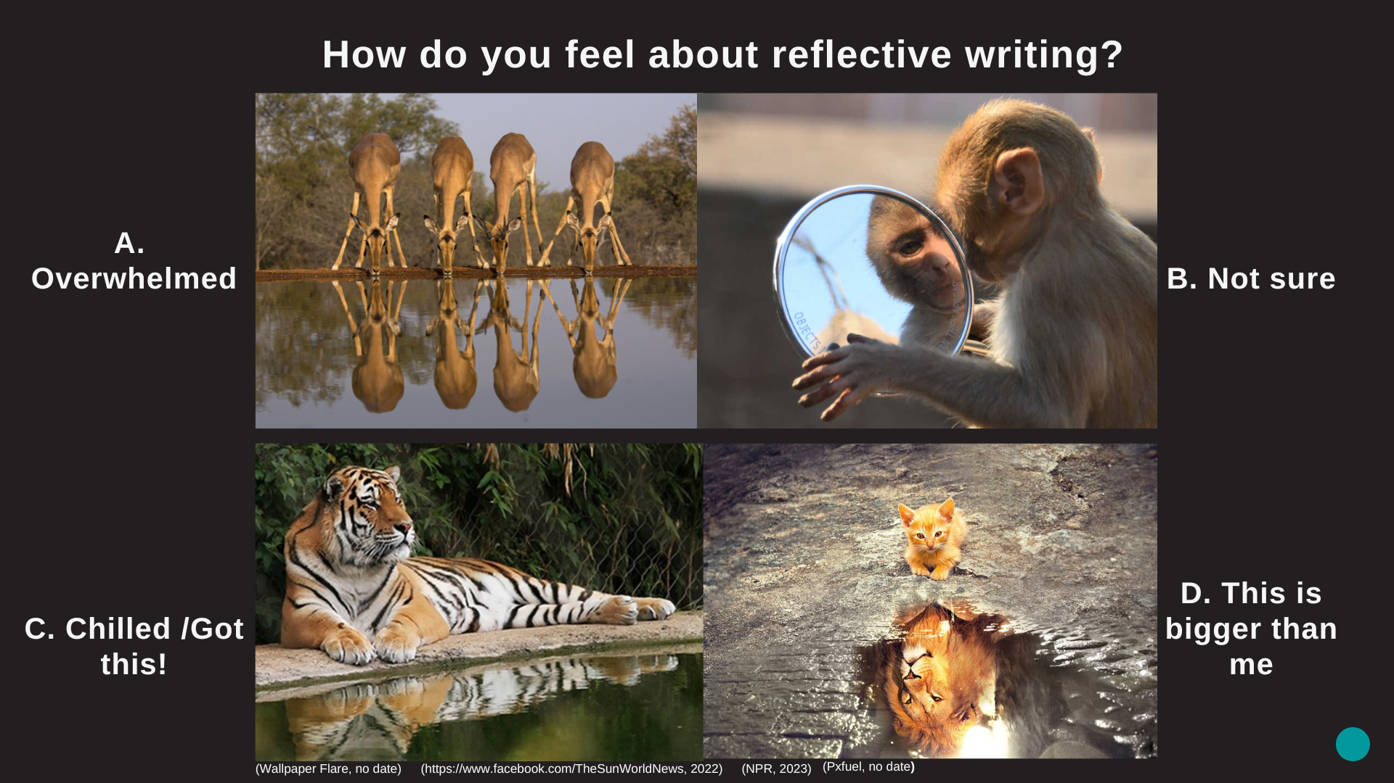
Notes:
Open question. Describe images. 3 mins

Slide 4


Notes:
Ask question openly. Padlet. 5mins. Closely linked to reflective thinking. Feedback.

Slide 5

What is Reflective Thinking?
Reflective thinking is part of your normal creative process, you do it all the time when you review and analyse your work.
Reflective writing develops your reflective thinking and helps you improve your work.
Reflection enables you to think critically about your work.
Notes:
Rhetorical question. Reflective thinking and writing closely linked. Difference between critical and reflection – Critical - Critical thinking is sometimes called directed thinking because it focuses on a desired outcome. Reflective - Reflective thinking, on the other hand, is a part of the critical thinking process referring specifically to the processes of analyzing and making judgments about what has happened.

Slide 6
Your MA User Experience Design Brief
Spring, Term 2
Macro UX (20 credits)
The Macro UX unit involves working with an external partner on live briefs. You can choose to work with industry or third sector organisations around a set of broad themes including; UX for smart city technologies, UX for cultural placemaking, UX for the future of publishing and UX for archives and collections.
Collaborative Unit (20 credits)
The Collaborative Unit is designed to enable you to identify, form and develop collaborative working relationships with a range of potential partners. These could be postgraduate student colleagues at the college or university level; postgraduate students at other Higher Education Institutions; external parties (e.g. companies, cultural organisations, community-based groups, NGOs, charities etc.)
Notes:
From Handbook

Slide 7
Macro UX Brief
Assessment Description
1. A reflective project diary (blog) showing evidence of your research, outcomes and development process through the unit. This online diary should consist of weekly posts, up to 450 words in length each. Visual and moving image material should also be included.
2. A 750 - word essay of critical and contextual writing, engaging with the theoretical content of the unit, and relating it to your practical work.
Learning Outcomes
LO1 Identify and pursue a personal UX design research interest, express it in various forms and communicate it to others. (Enquiry, Communication)
LO2 Reflect in written and visual form how your work is positioned to the field of UX design practice. (Knowledge, Process)
LO3 Demonstrate and define a critical understanding of the future of UX design and your own role within it. (Process, Realisation)
LO4 Demonstrate how you would effectively collaborate within various levels of an organisation (Process)
Notes:
From Handbook

Slide 8
Collaborative Unit
Learning Outcomes
LO1 Demonstrate initiative and personal responsibility in researching collaborative opportunities and developing them at a professional level through networking, negotiation, research and planning skills in the context of user experience design (Process).
LO2 Critically engage in an agreed collaborative learning project that cuts across disciplines that will demonstrate advanced research, application of theoretical approaches to your proposed issues and contexts, and a comprehensive analysis of what you wish to do and why (Enquiry, Knowledge).
LO3 Demonstrate both independent and collaborative working required for personal and professional development through planning, negotiation, project management, and delivery (Process)
LO4 Demonstrate the learning gained from multi-disciplinary collaboration through a high-level critical self-reflection that contributes to personal and professional development. This should be done on a project blog (Process, Realisation).
Assessment Description
The assessment for this unit is through a portfolio of work that will include research, project work, critical analysis and an individual critical self-reflection on the nature of collaborative working and learning.
Notes:
From handbook

Slide 9
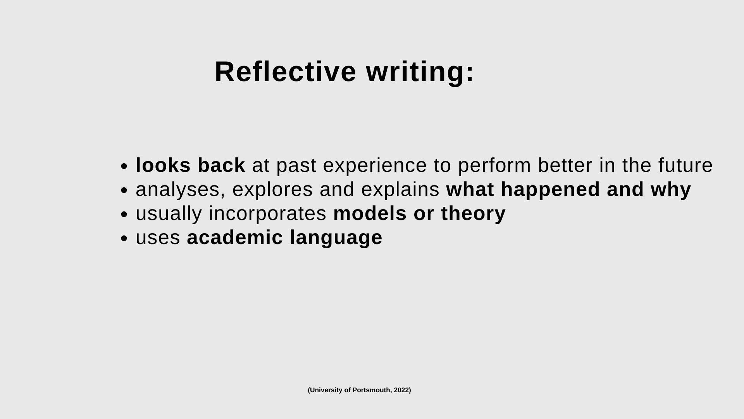

Slide 10
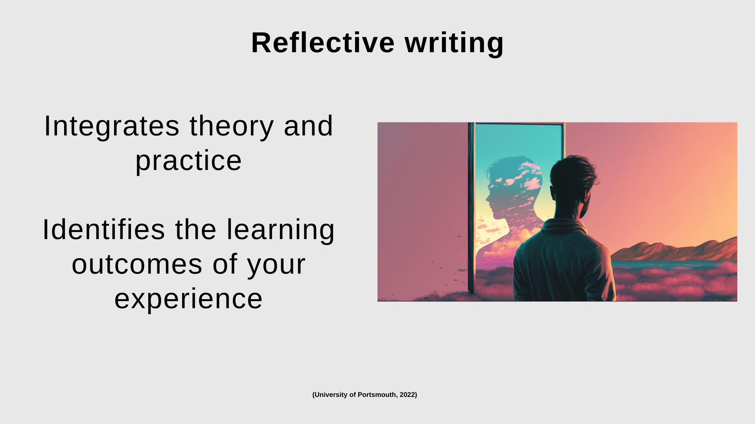
Notes:
Theory and practice should connect.

Slide 11
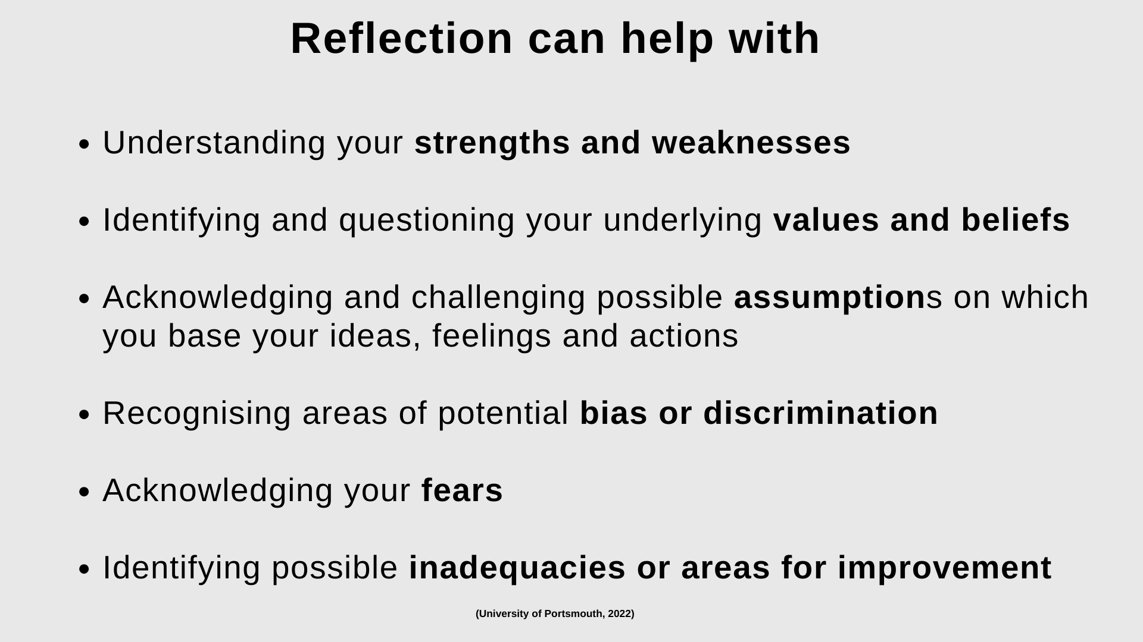

Slide 12
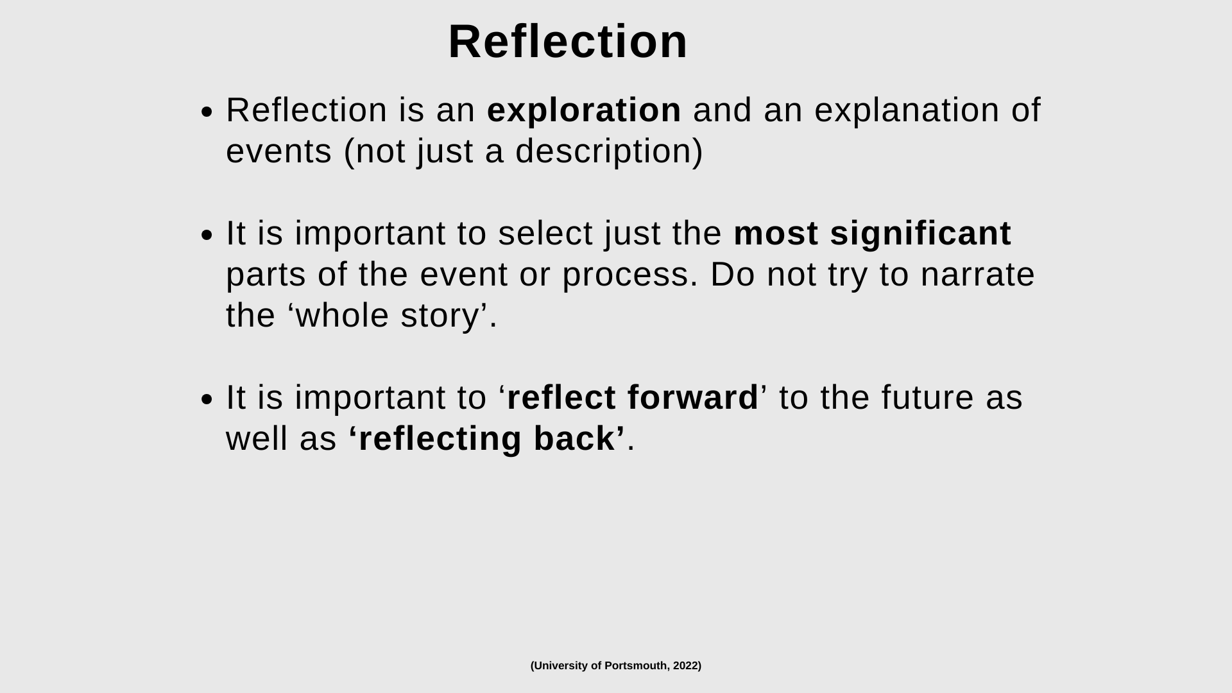

Slide 13
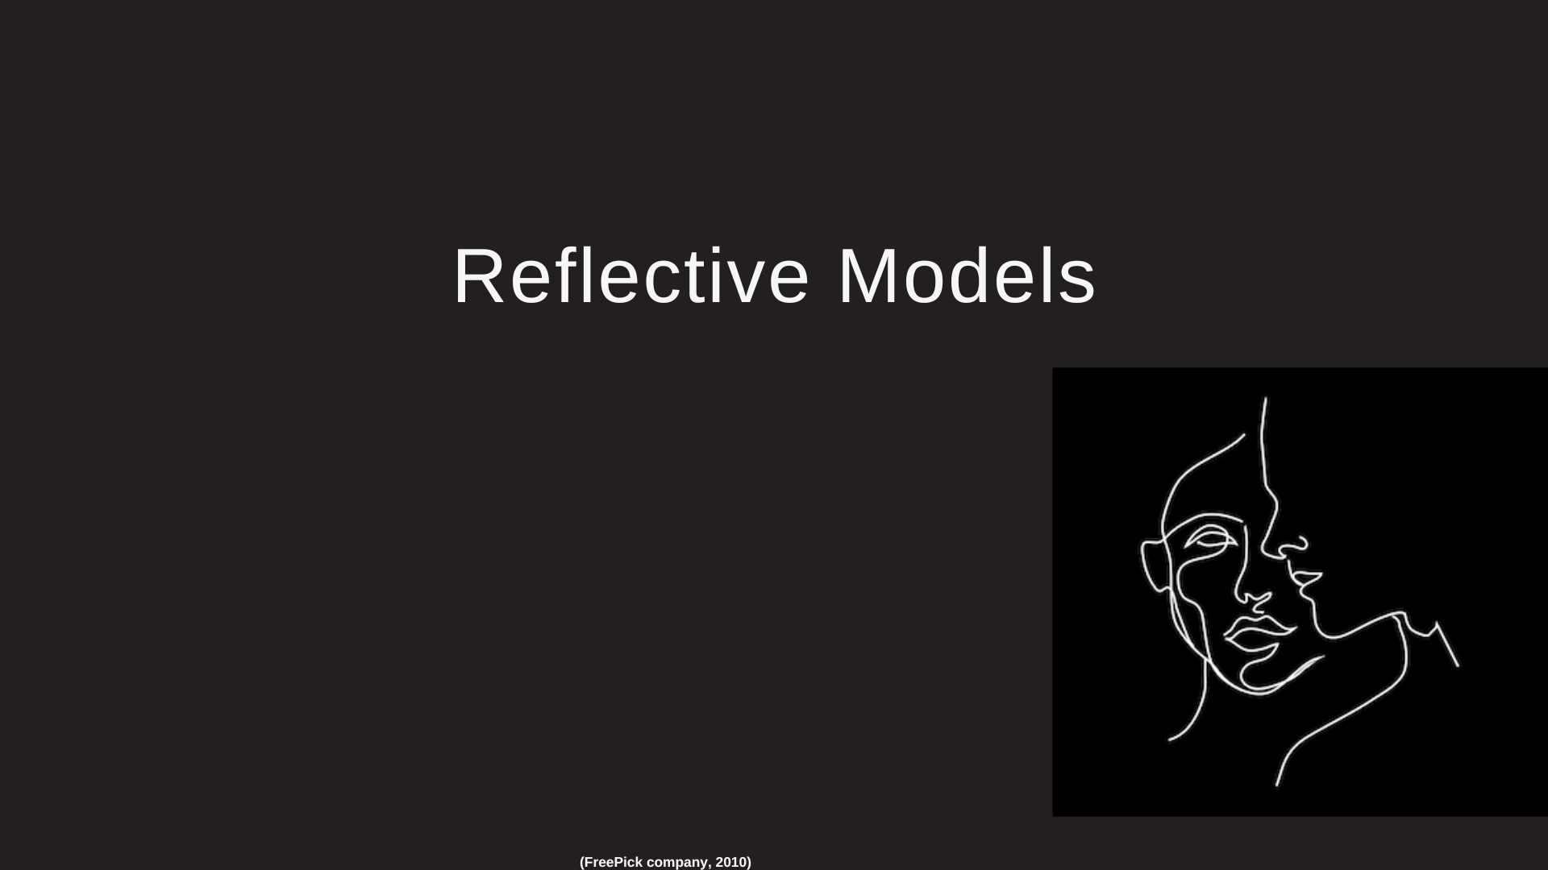

Slide 14
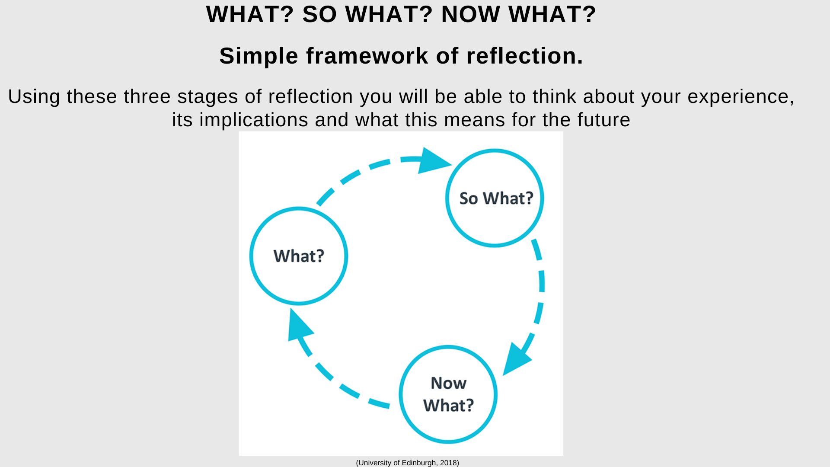

Slide 15
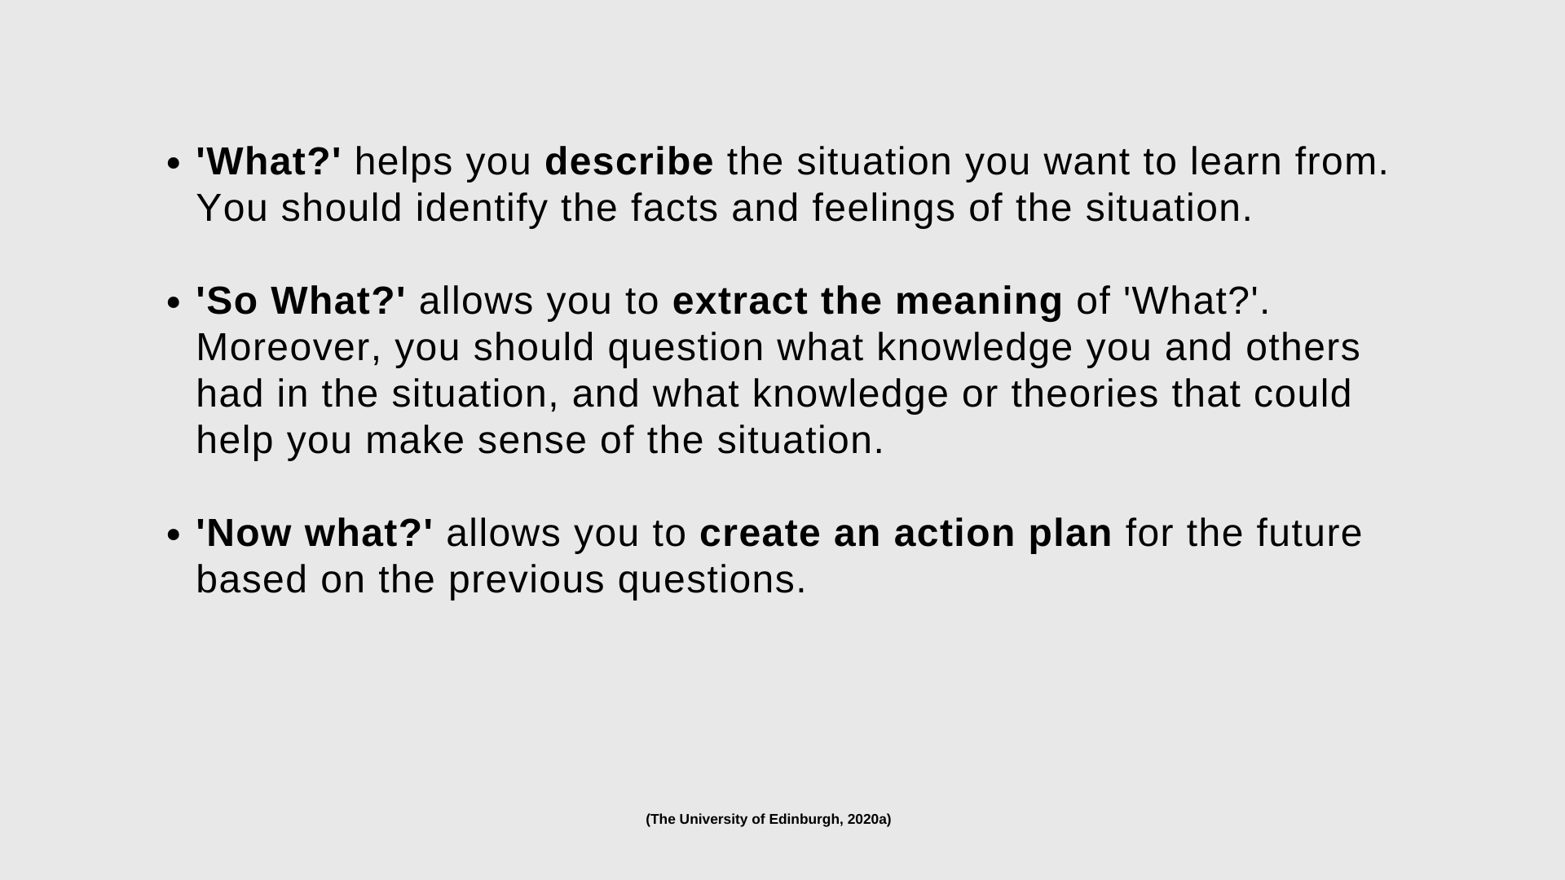

Slide 16
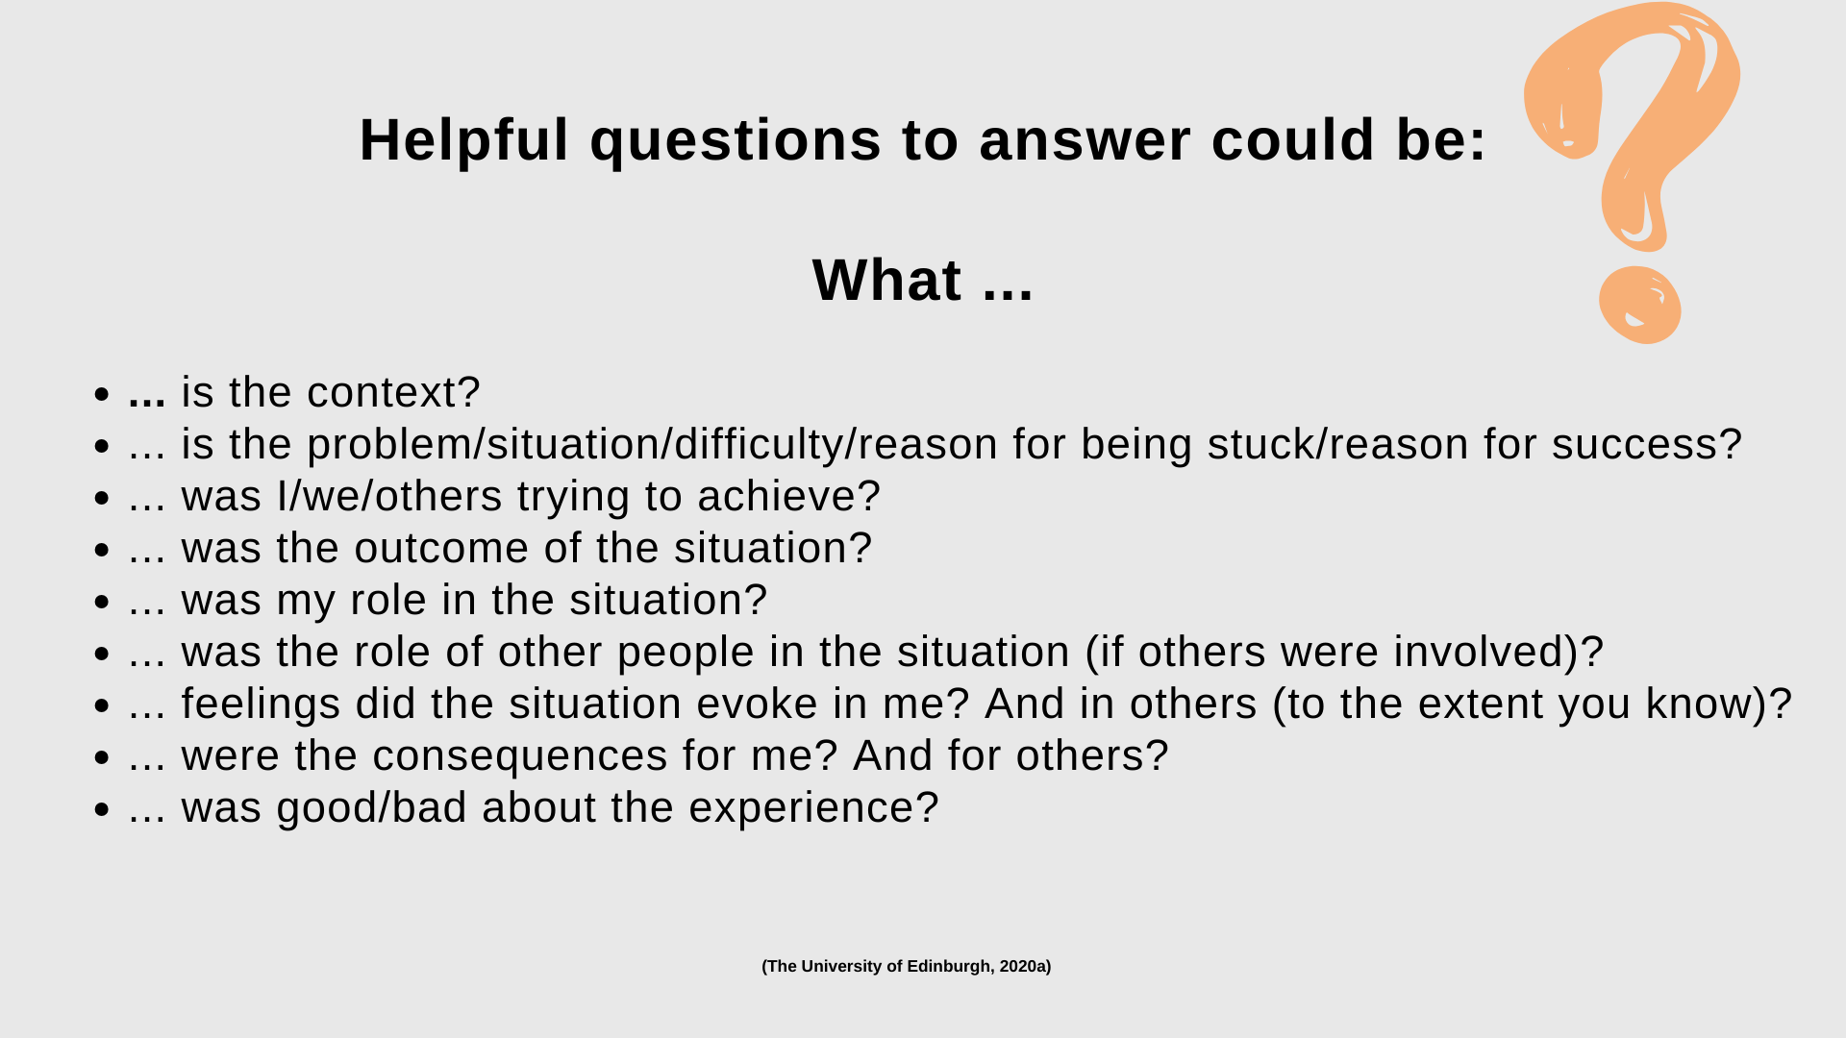

Slide 17
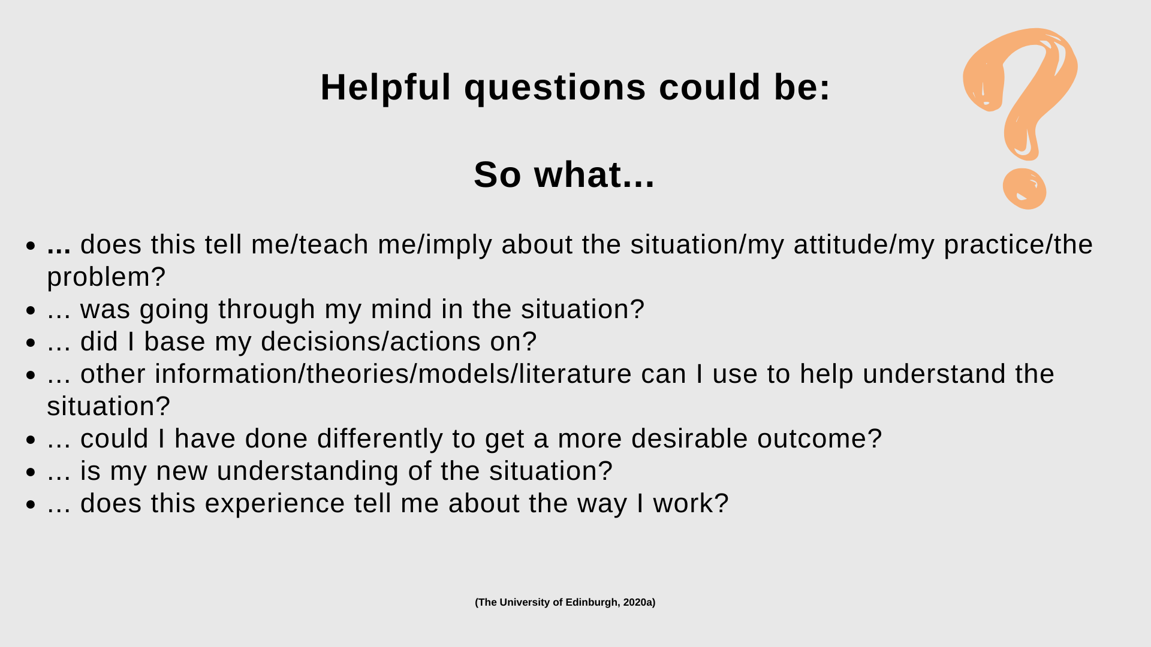

Slide 18
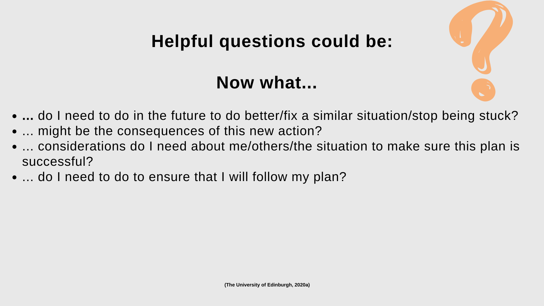

Slide 19
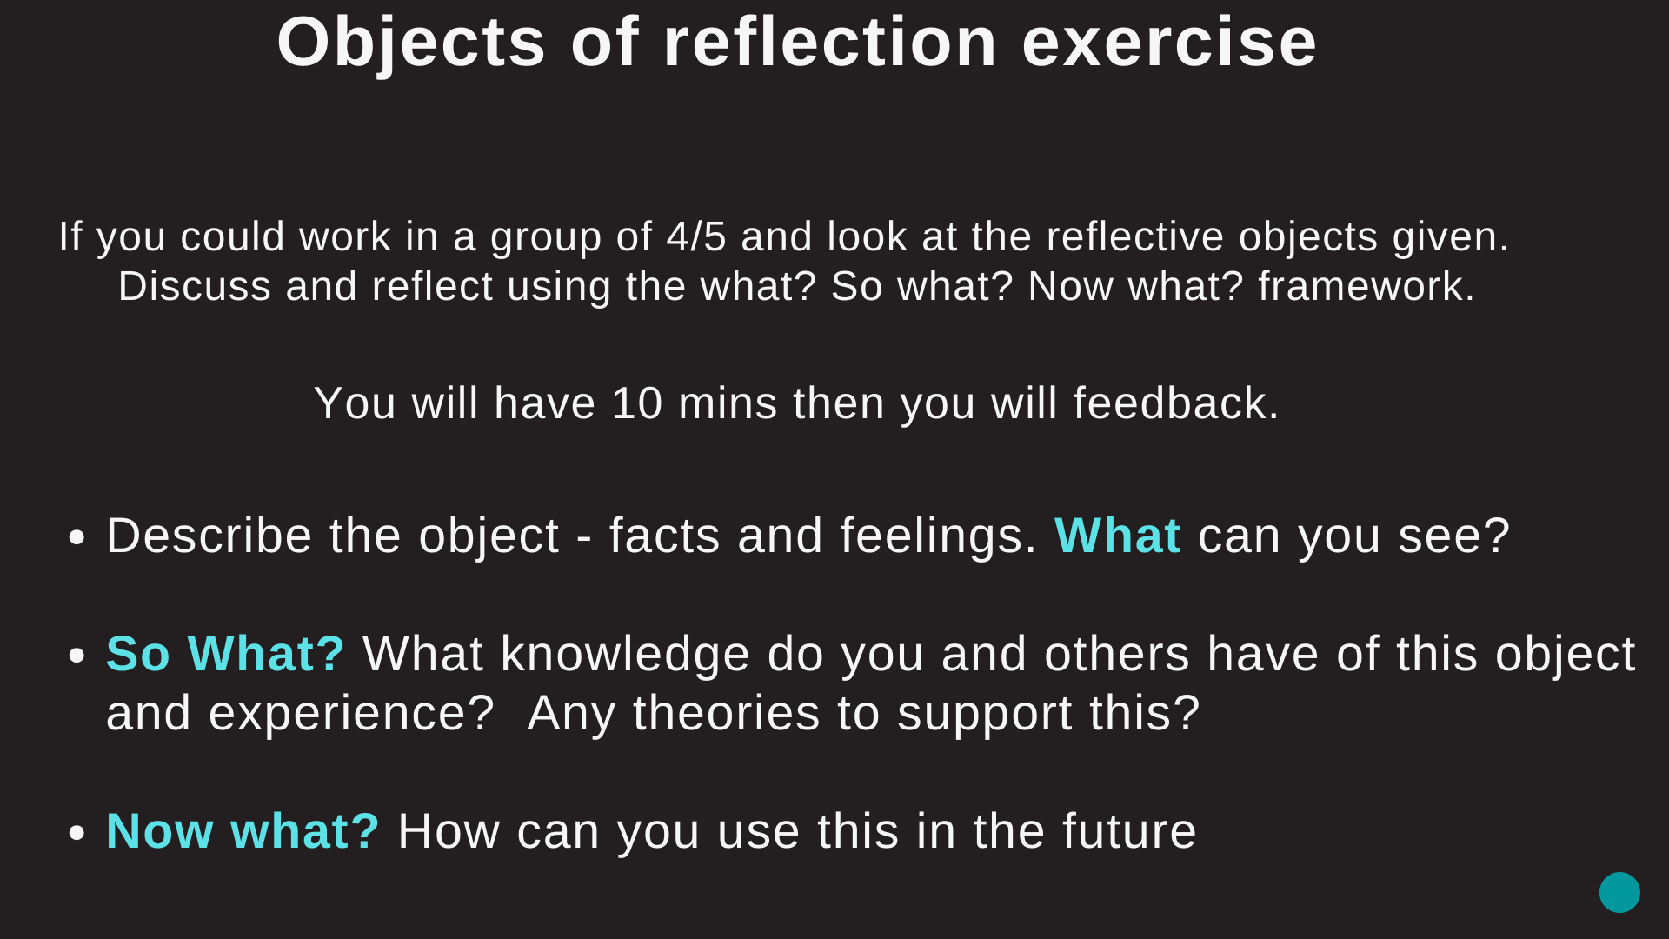
Notes:
10 mins. 1 min each group allow 5 mins. This is just demonstrating how you can take a simple object/idea/concept and once you ask reflective questions you can unpack a lot of information that can be used to develop further ideas and creative pathways.

Slide 20

Notes:
Another good reflective model you can use.

Slide 21
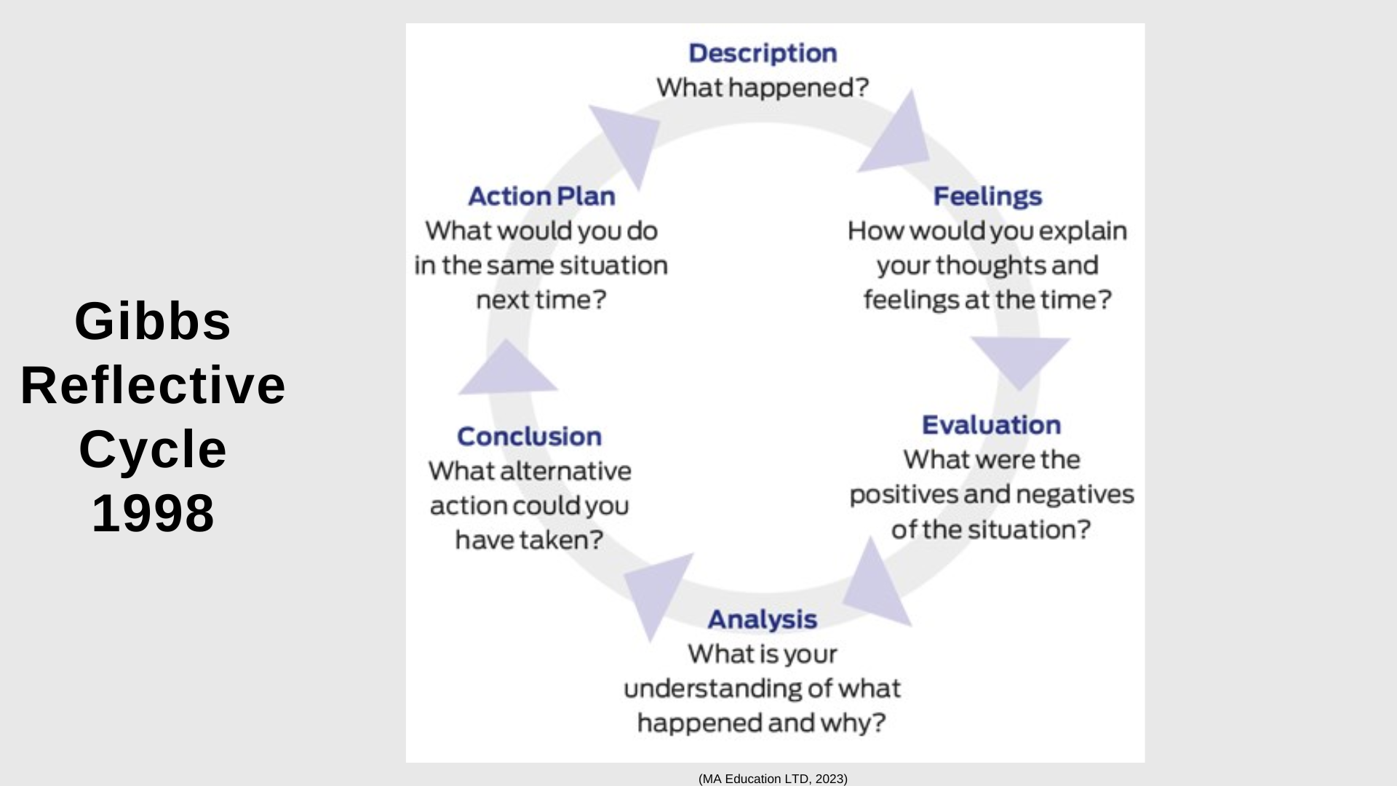

Slide 22
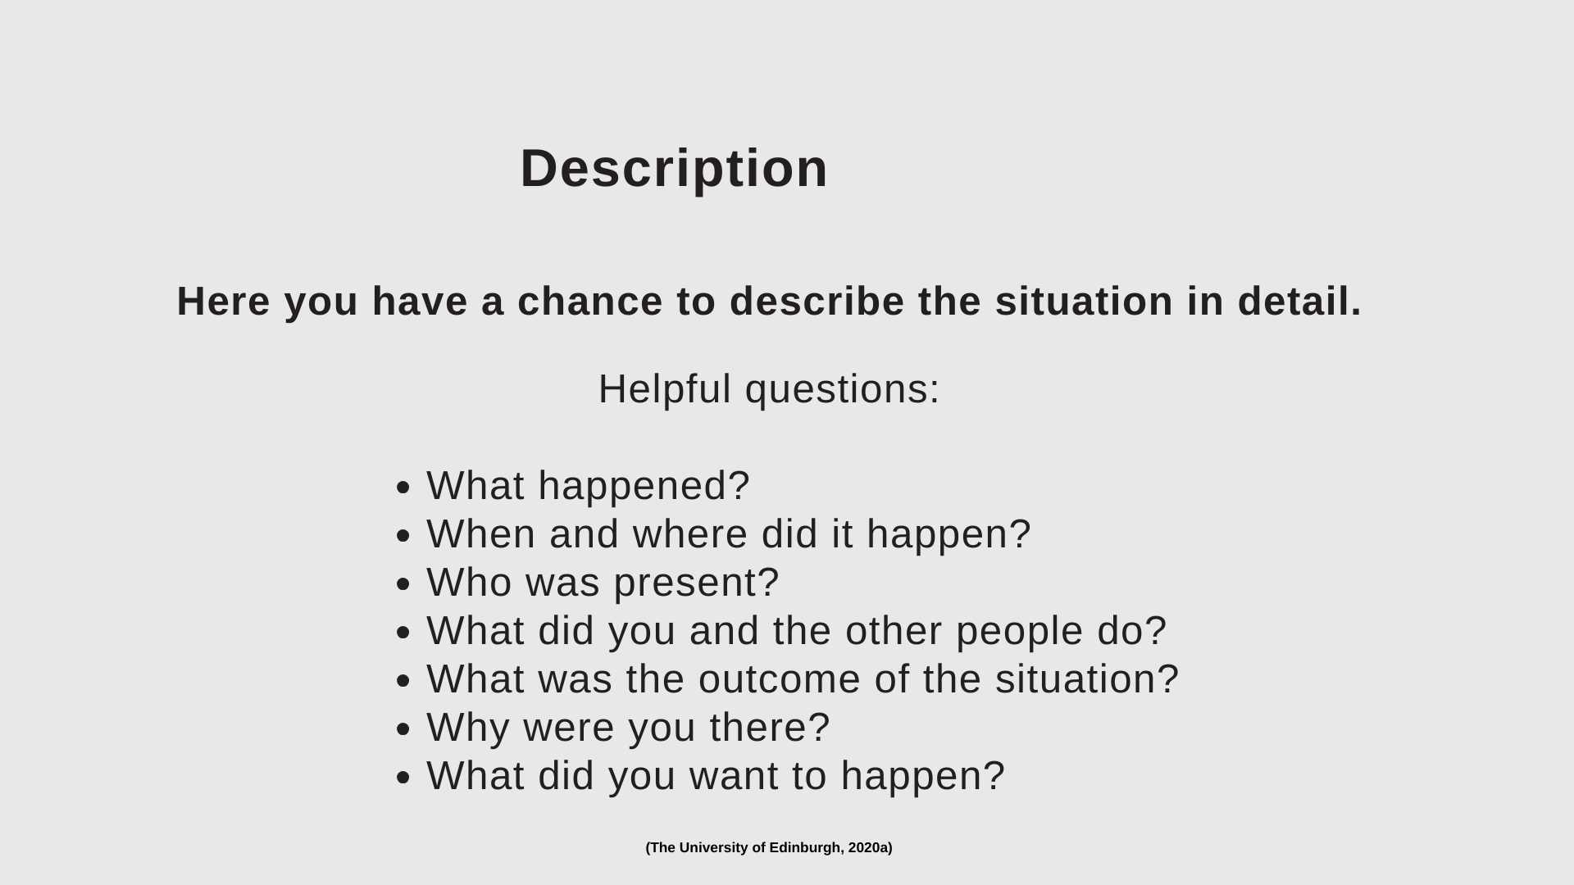

Slide 23
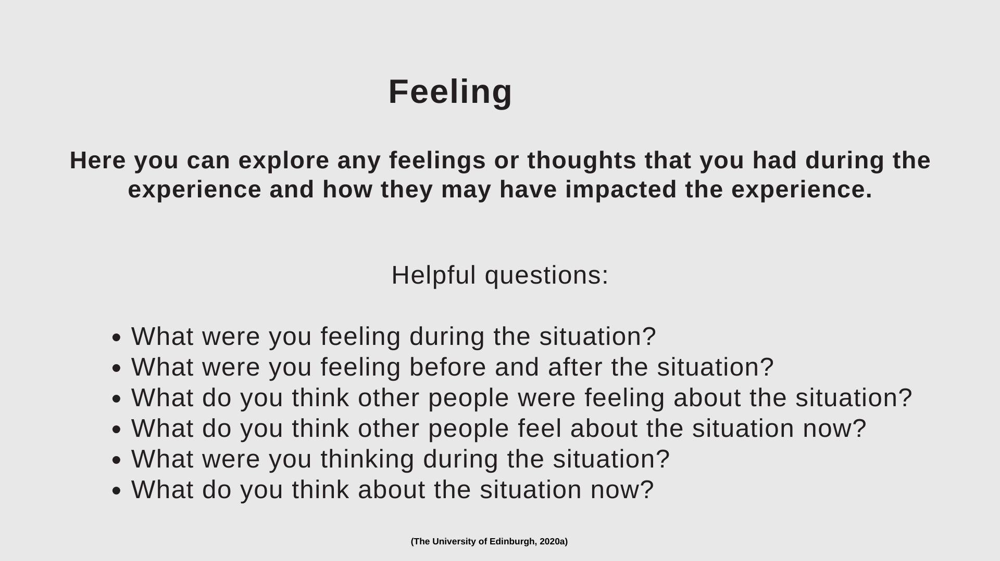
Notes:
Be careful not to use to many ‘I’ and ‘my’ for this may suggest a lack of objectivity. Reflective writing is more personal than other kinds of academic writing.

Slide 24
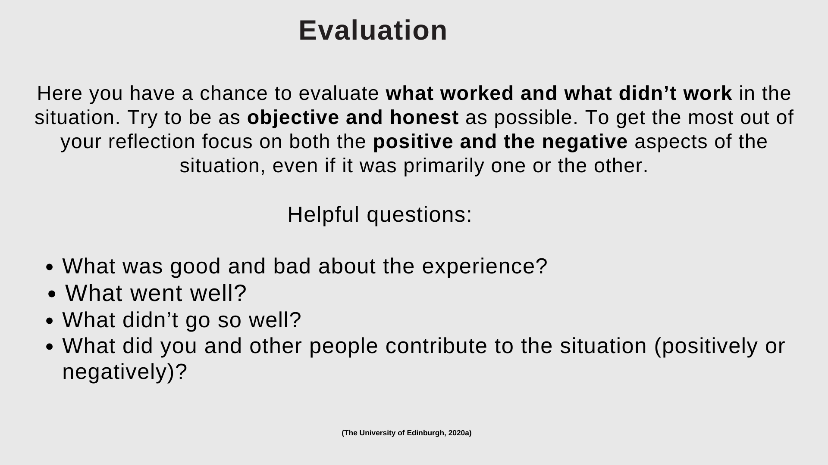

Slide 25
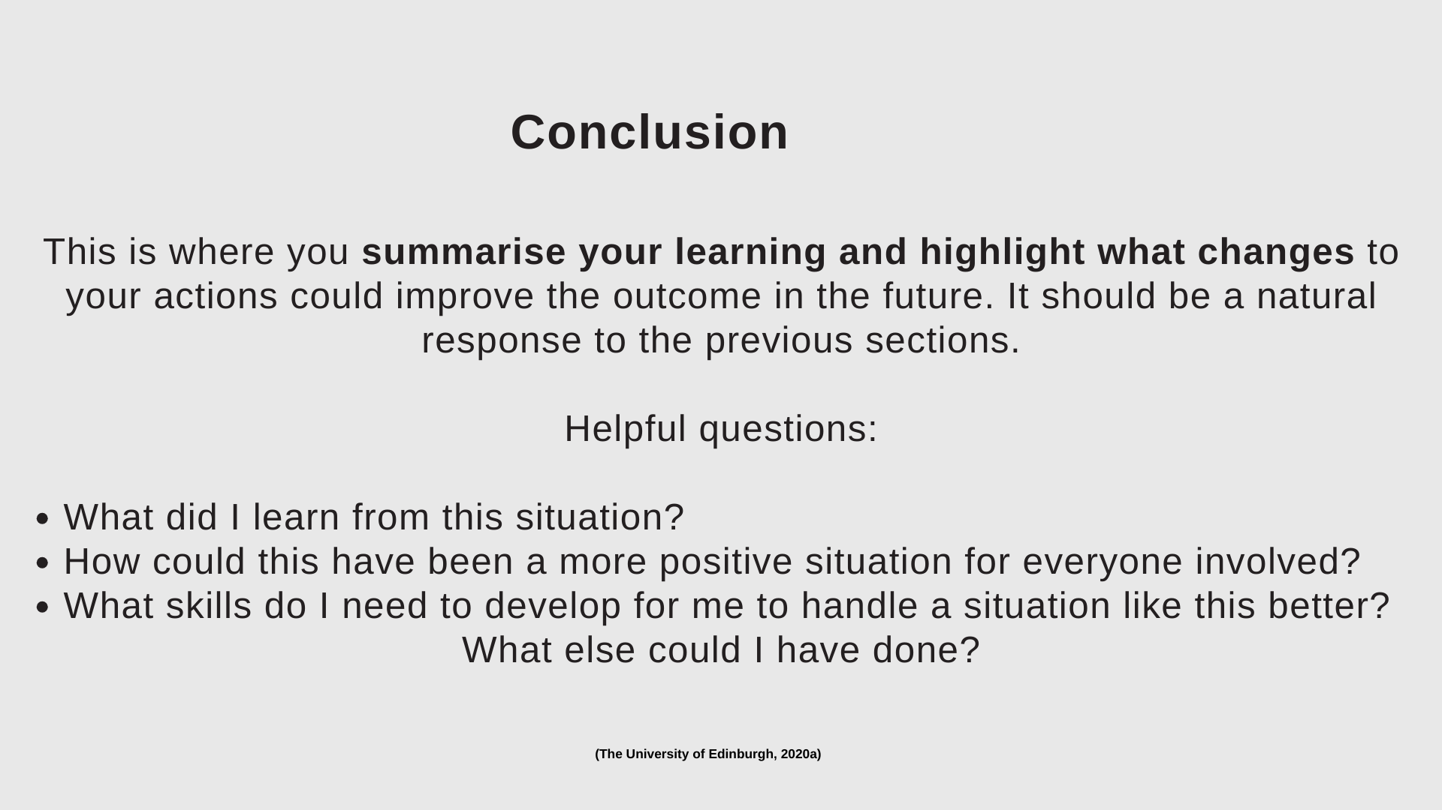

Slide 26
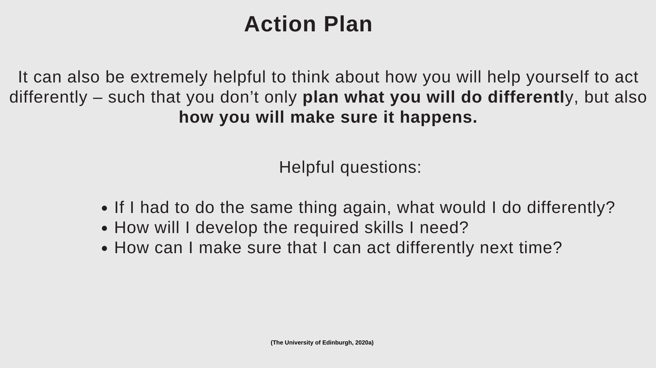
Notes:
Reflecting forward. You don’t have to answer all of them but they can guide you about what sort of things make sense to include in that stage. You might have other prompts that work better for you.

Slide 27

10 minute break
Notes:
Here at 10.55am

Slide 28
Words relating to your course aims and learning outcomes, they are all related to reflection:-
Critiquing
Evaluation
Analytical
Creative problem solving
Notes:
To participate in the above reflection will be required.

Slide 29
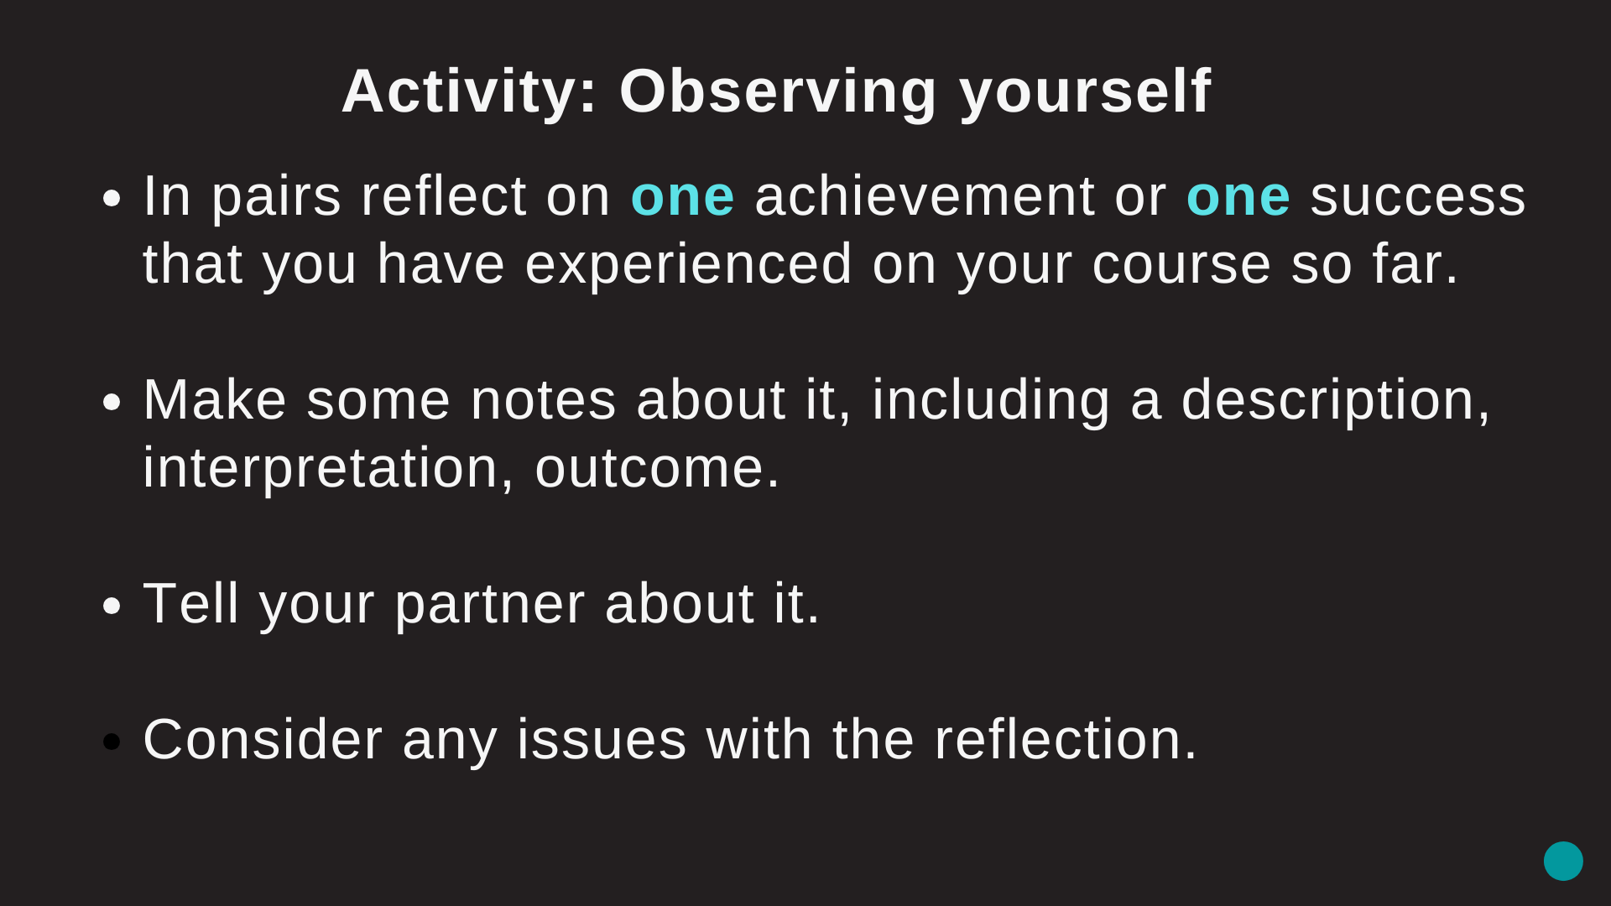
Notes:
Use the sheets given . You will be required to look back at your units completed and draw on these skills, knowledge and experience gained, as well as research methods, theoretical frameworks and your creative practice. Allow 10 mins and feedback. 5mins for exercise and 5 mins for feedback

Slide 30
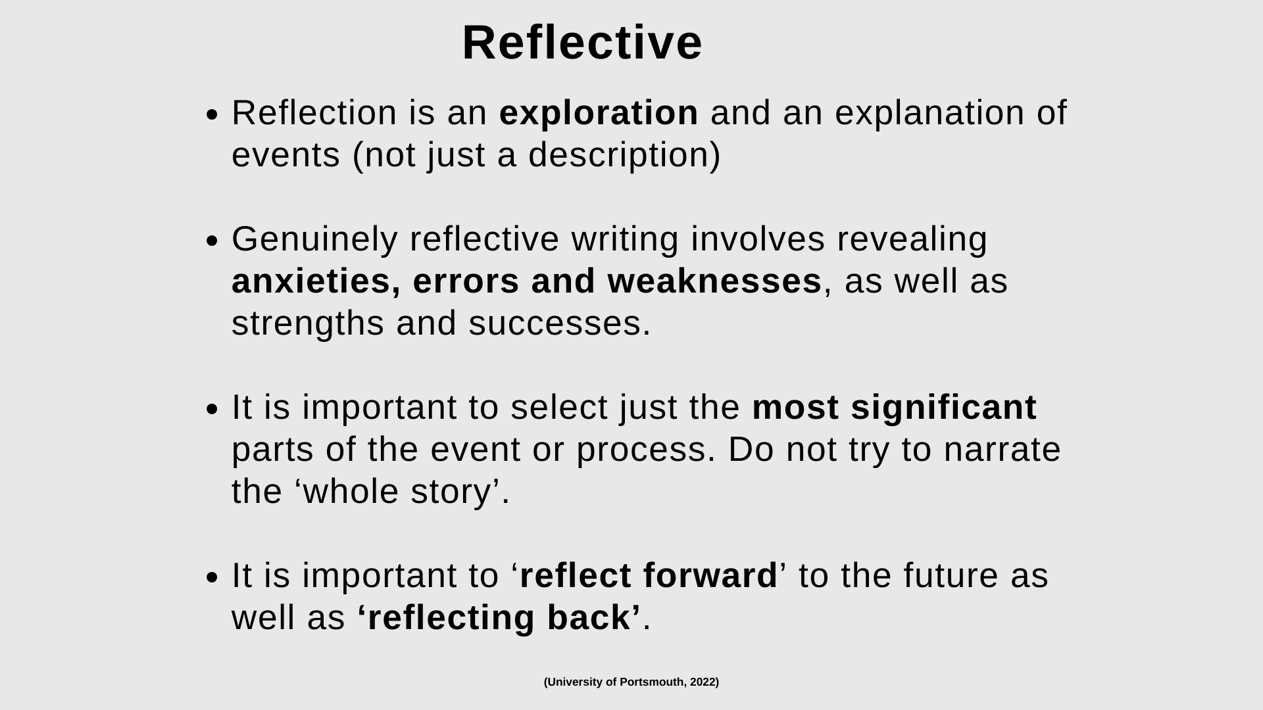

Slide 31


Slide 32
What should I write about?
Research – who inspires and influences your work? and why?
Idea development – how are your ideas and concepts developing?
What materials and processes you are exploring?
Feedback from tutors and peers in group crits, presentations, tutorials and collaborative work .
You should reflect on and write about all aspects of your work and study!

Slide 33
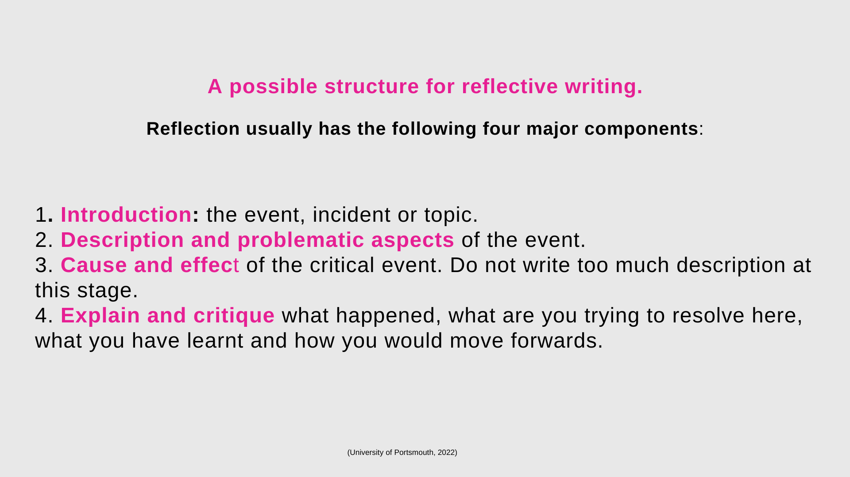

Slide 34
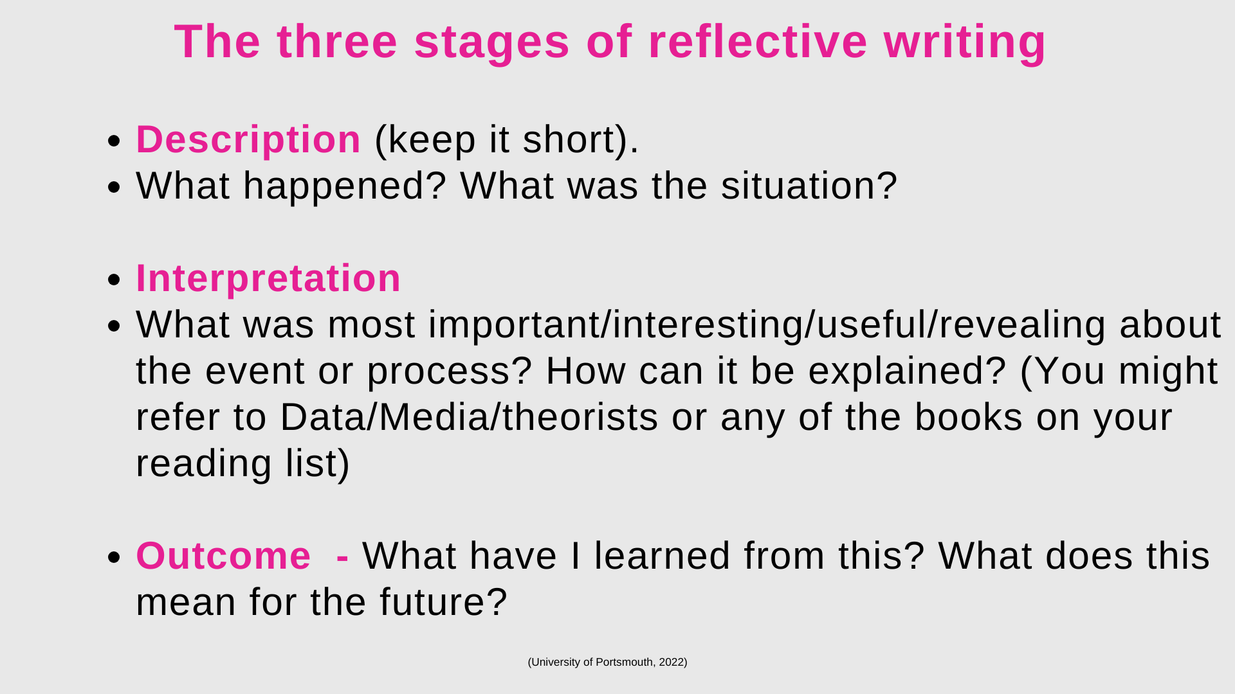

Slide 35
Notes:
Give hand outs for questions you can use to structure your reflective writing.

Slide 36
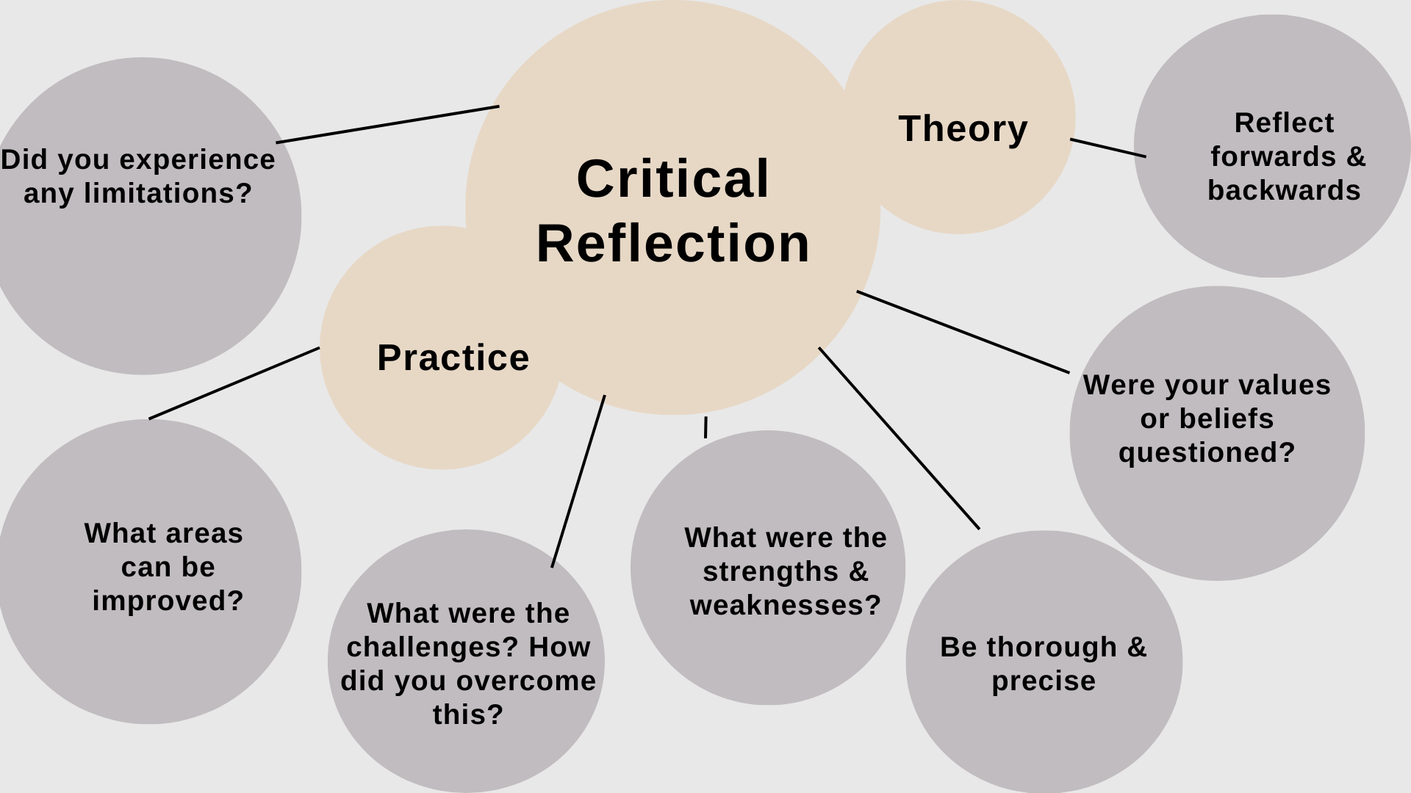
Notes:
Theory and practice should be aligned.

Slide 37

Any Challenges with Reflective Writing?
Write on the Post it notes given and leave on your table.
Then swop tables and the new group will offer some useful solutions, and we will share one idea from each table.
Notes:
Post it notes. 10 mins. 5 mins to write and move and 5 mins to feedback

Slide 38

Notes:
10 mins, 5 mins to review and 5 mins to feedback

Slide 39
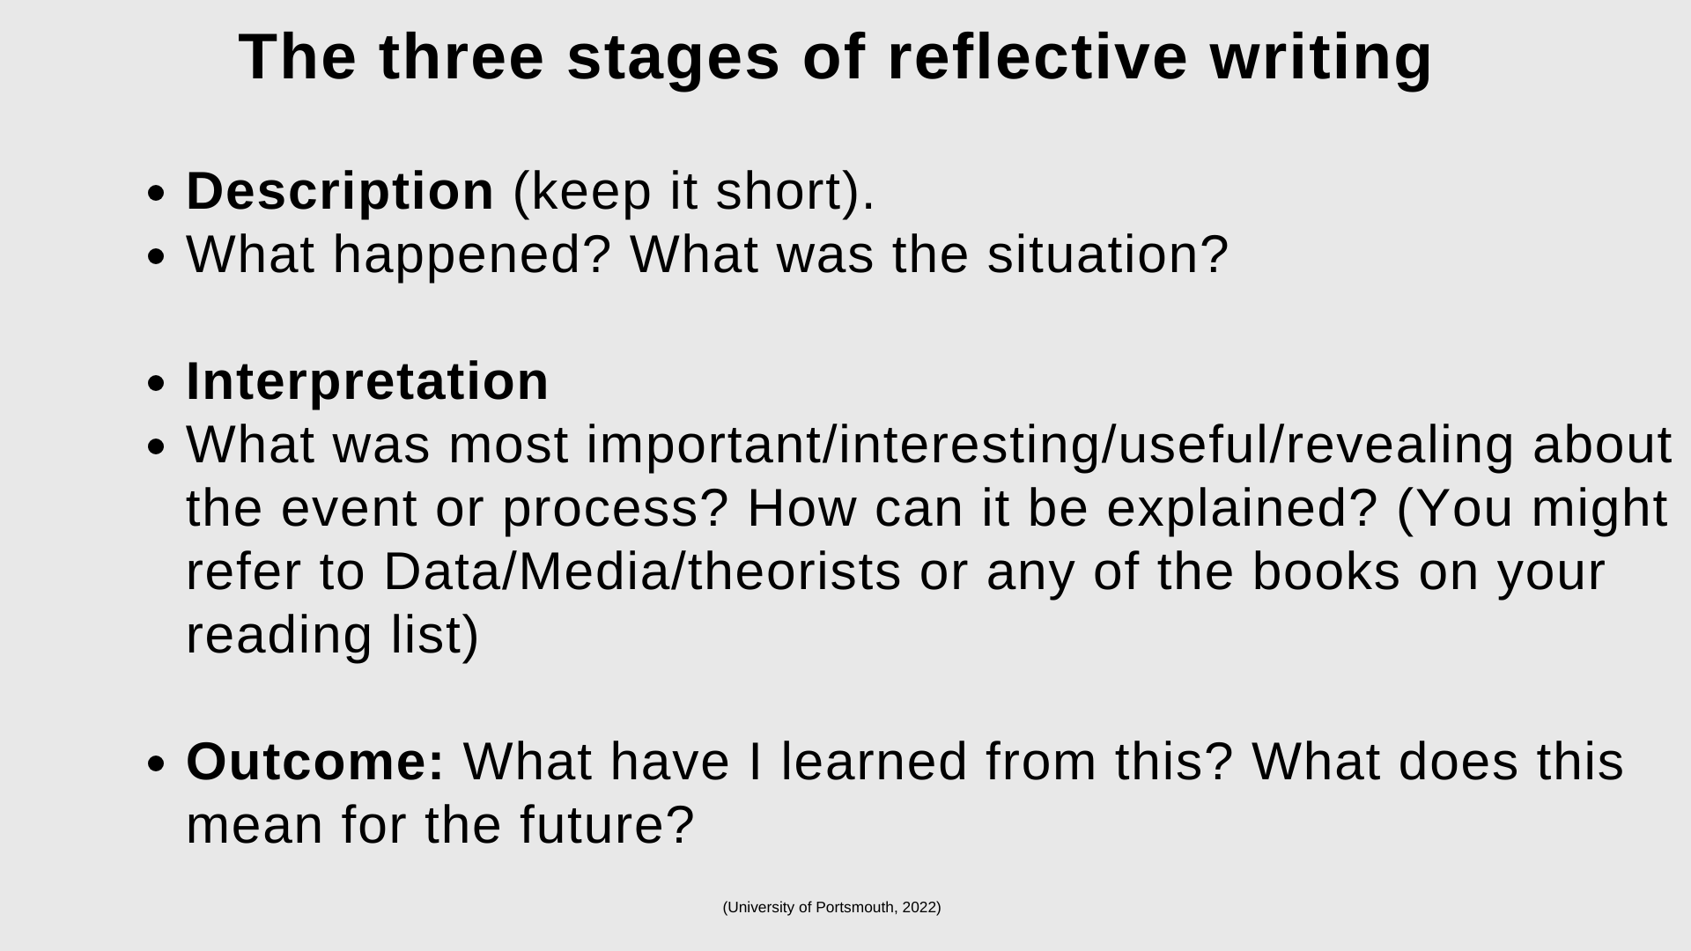
Consider
Notes:
Consider for the exercise.

Slide 40
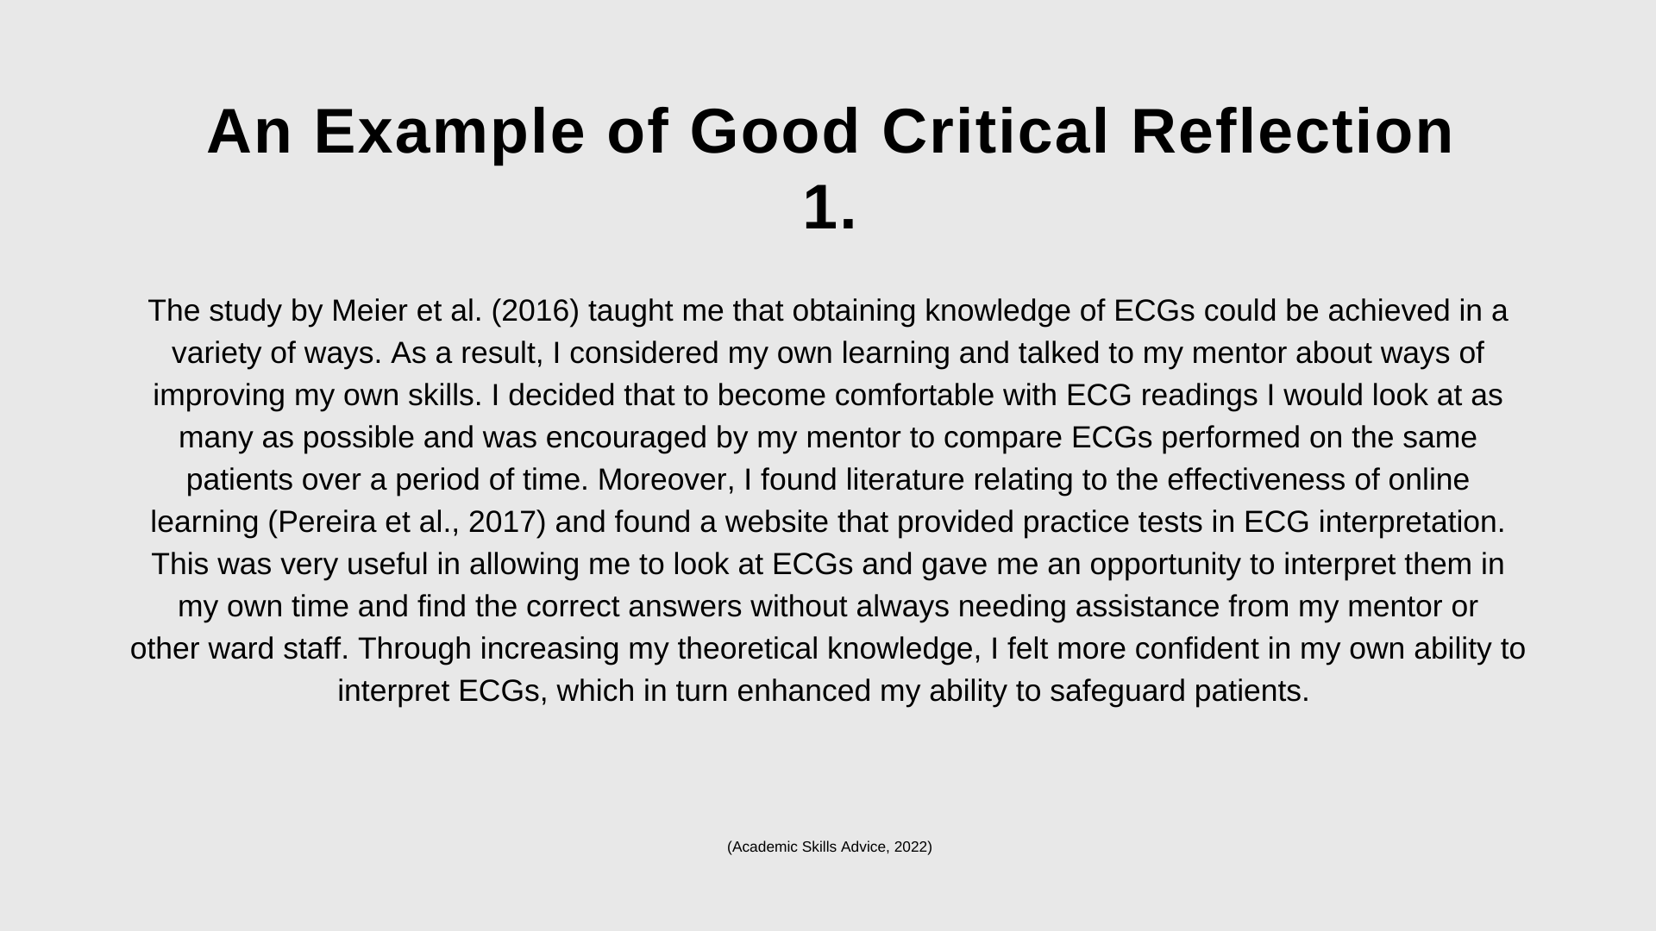
Notes:
5 mins. Hand out. Medical student.

Slide 41
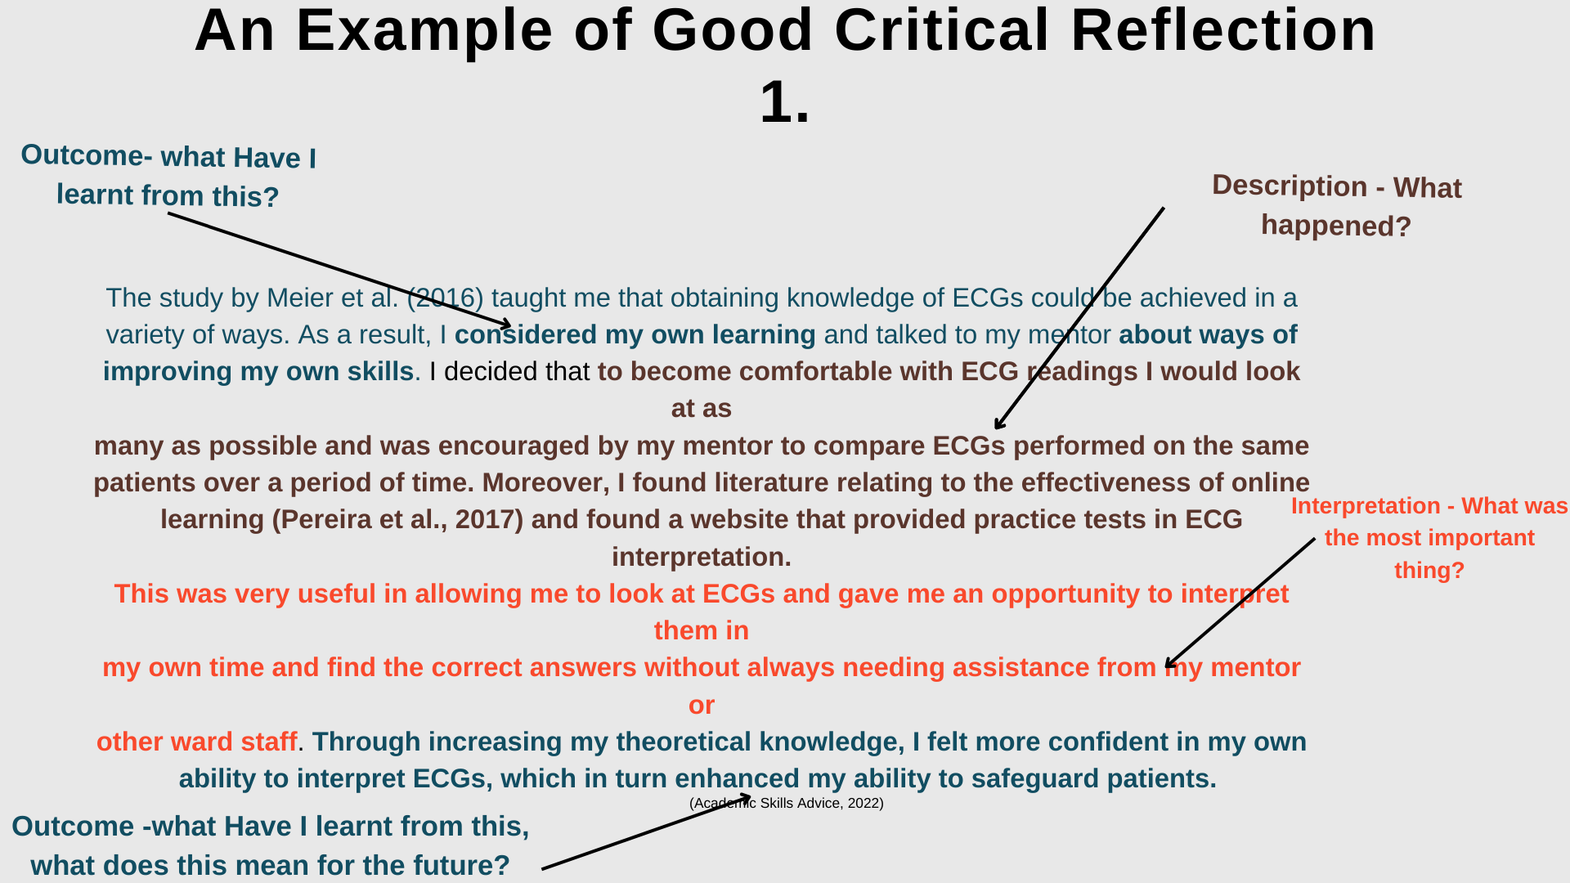
Notes:
Answers to example.

Slide 42

Some common problems to
avoid:
Your writing is too descriptive (only telling us what you did), not giving much analysis or evaluation.
You have not written it throughout your project and forgotten important information.
It is too much of a general overview and does not highlight critical stages.
There isn’t a balance between positive and negative review.
Notes:
Similar to when we looked at critical writing

Slide 43
What has this workshop reminded you of about reflective writing?
Notes:
3 mins students feedback

Slide 44
Important things to remember:
Try and engage with reflective writing as often as possible. If you write a few sentences every day, critically reflecting on your creative developments, you’ll be able to analyse your work in a relevant, proactive and developmental way.
If you leave reflective writing until the end of a project you will find it difficult to reflect meaningfully and with purpose.
Writing and making are closely linked; one informs the other. The more your critically reflect on your work the stronger your creative voice will be.
Your reflective writing should be useful to you and help you to establish where your practice has been, where it is now and where it may go next.

Slide 45

Notes:
Hand out the vocabulary guide. Our experiences have an impact on how we reflect and view the world this is incorporated in reflective writing.

Slide 46

Have you registered?

Slide 47
Contact Academic Support
Room: T122A (in the LCC library)
Email: academicsupport@lcc.arts.ac.uk
Academic Support Online (ASO):
https://academicsupportonline.arts.ac.uk
Academic Support Online (ASO) LCC: https://academicsupportonline.arts.ac.uk/directory/academic-support-london-college-communication

Slide 48


Slide 49
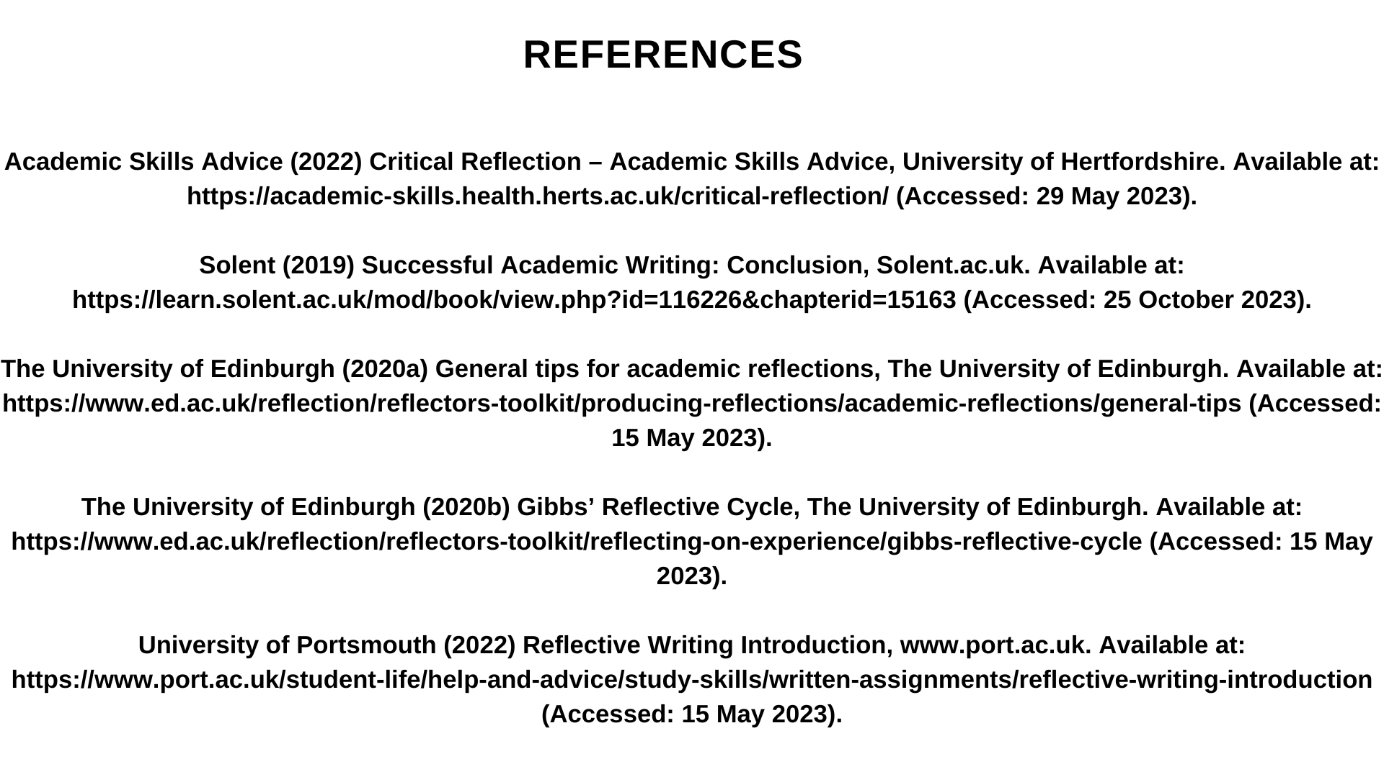

Slide 50
